Slide 1
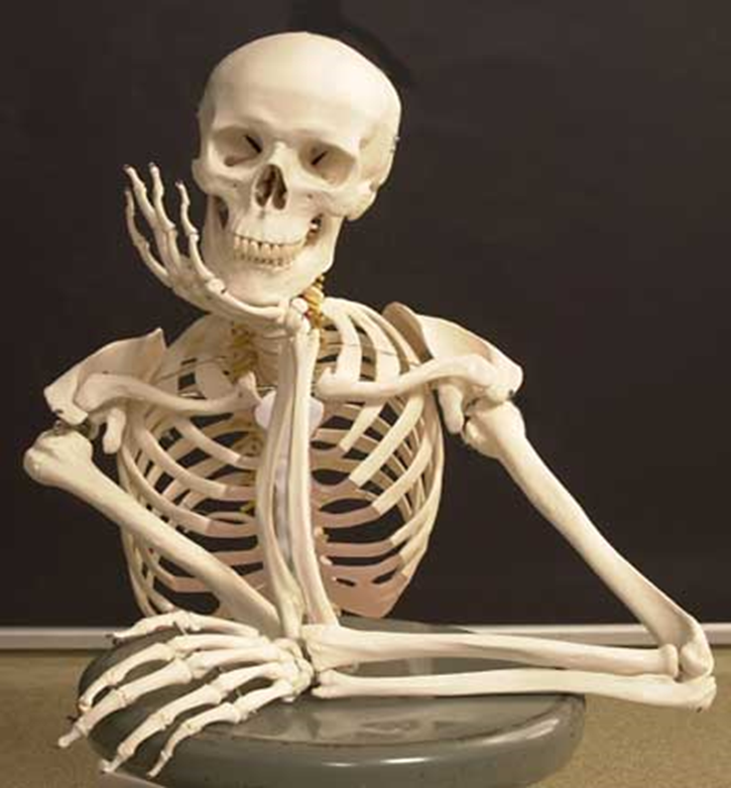
Bones

Slide 2
Objectives
Define the bone.
Describe state the characteristic features of bones.
State the functions of bones.
State the classification of bones giving examples.

Slide 3
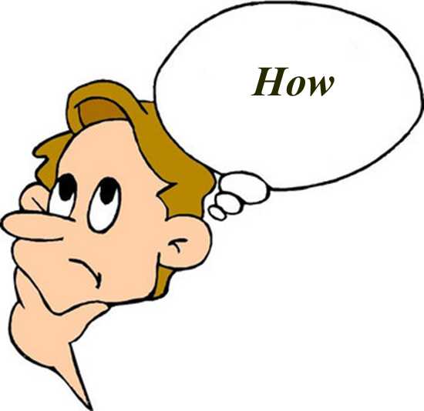
What is bone?

Slide 4
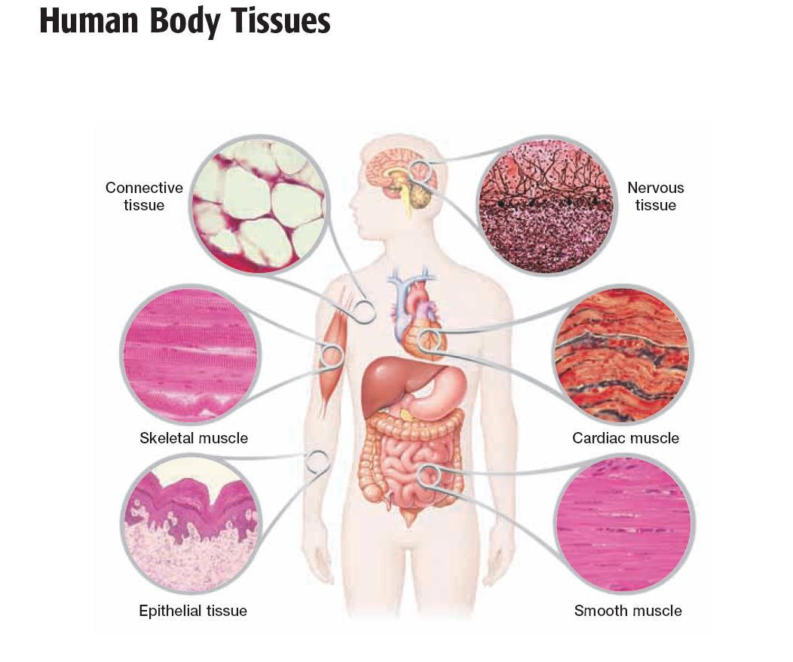

Slide 5
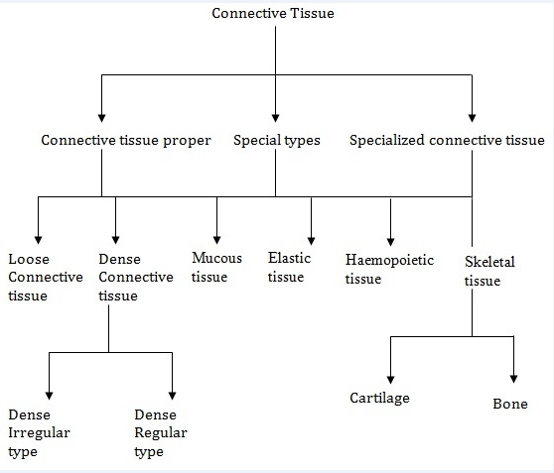
Adipose tissue

Slide 6
Functions of Bones
Support
Provide rigid structural frame work for the entire body
Movement
muscles attach by tendons & use bones as levers to move
Protection
Skull – brain
Vertebrae – spinal cord
Rib cage – thoracic organs
Mineral storage
Calcium and phosphorus
Released as ions into blood as needed
Blood cell formation and energy storage
Bone marrow: red makes blood, yellow stores fat
Notes:
The formation of blood cells, (hematopoiesis), takes place mainly in the red marrow of the bones.
In infants, red marrow is found in the bone cavities. With age, it is largely replaced by yellow marrow for fat storage.
In adults, red marrow is limited to the spongy bone in the skull, ribs, sternum, clavicles, vertebrae and pelvis. Red marrow functions in the formation of red blood cells, white blood cells and blood platelets.

Slide 7
Basic components of connective tissue
Cells
+
Extracellular matrix
variety of fibres
ground substance

Slide 8
Bones – specialized connective tissue
Cells : osteogenic/osteoprogenitor cells, osteoblasts, osteocytes & osteoclasts
+
Extracellular matrix
Collagen fibres
Type 1
Proteoglycans
Bone minerals/Inorganic salts
Calcium hydroxyapatite crystals
65-70%

Slide 9
Bone Characteristics
highly vascular
mineralized
hard & rigid
constantly changing
regenerating capacity

Slide 10
Bone Characteristics
canalicular system for transportation of nutrients
development :
from direct transformation of condensed mesenchyme through a cartilagenous model replaced by bone

Slide 11
Bone Classification
According to region
According to structure
According to shape
According to ossification

Slide 12
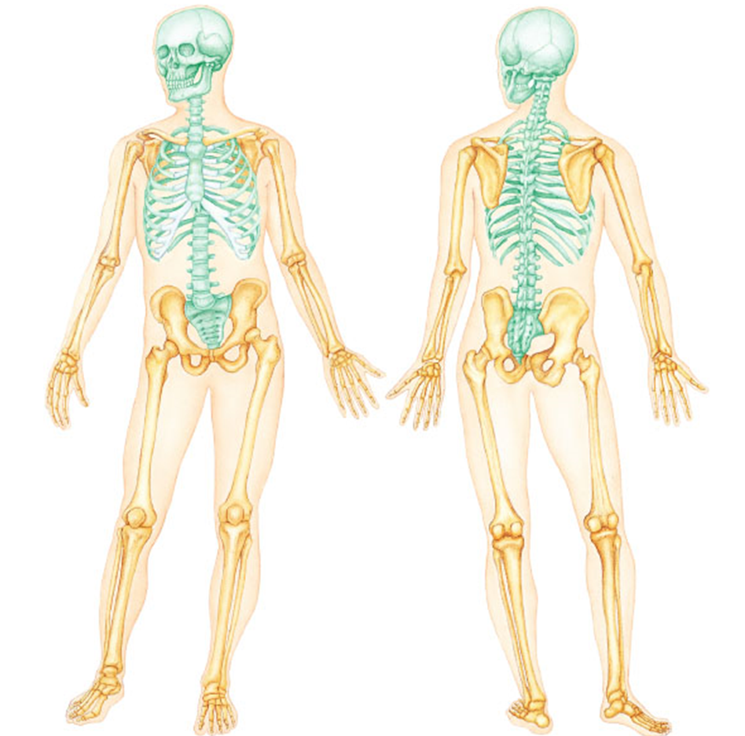
Bone Classification - According to Region
Axial skeleton
(80 bones)
Appendicular Skeleton
(126 bones)
Notes:
Axial skeleton supports and protects organs of head, neck and trunk
Axial skeleton:skull (cranium and facial bones), hyoid bone (anchors tongue and muscles, associated with swallowing), vertebral column (vertebrae and disks) bony thorax (ribs and sternum)
Appendicular skeleton includes bones of limbs and
bones that anchor them to the axial skeleton
Appendicular skeleton:pectoral girdle (clavicle, scapula), upper limbs (arms). pelvic girdle (sacrum, coccyx) , lower limbs (legs)

Slide 13
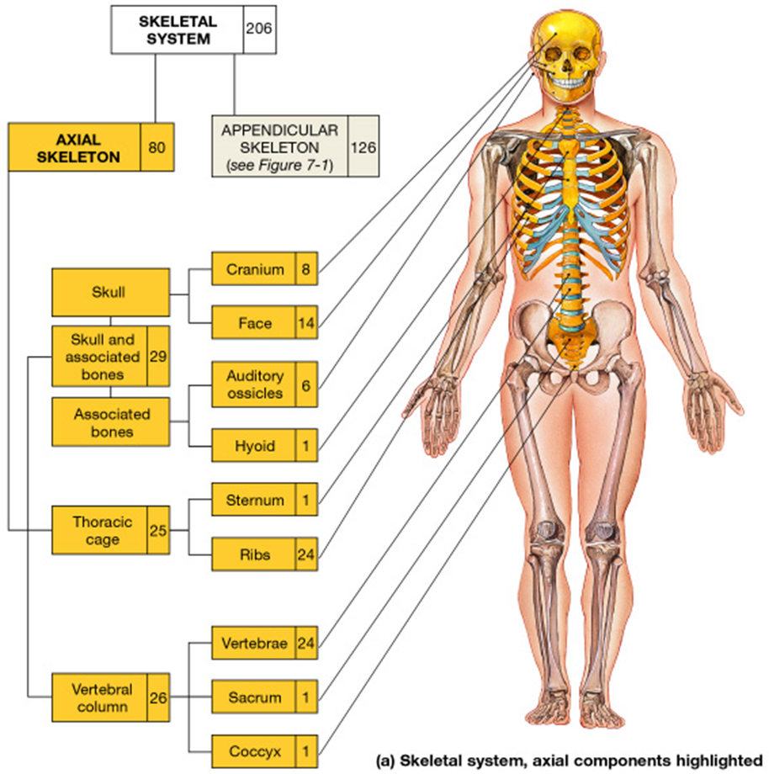

Slide 14
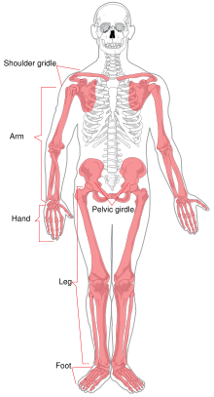
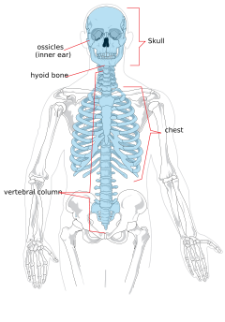
Axial skeleton
Appendicular Skeleton

Slide 15
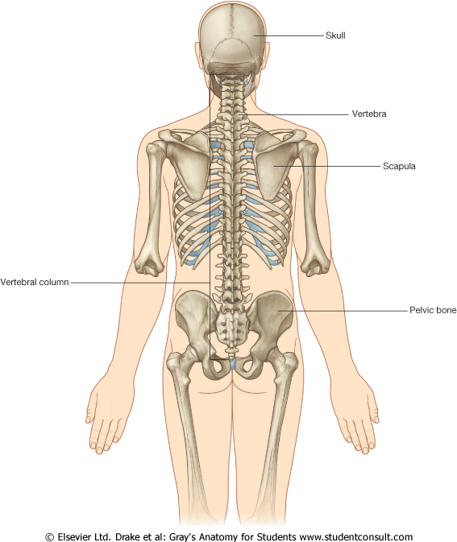
Composed of 126 bones of the upper (64) and lower limbs (62) and the bony girdles, which anchor the appendages to the axial skeleton.
The shoulder girdle (the scapula and clavicle)
The upper limb (the humerus, ulna, radius and bones of the hand)
The pelvic girdle (the hip bone)
The lower limb (the femur, tibia, fibula and bones of the foot)
The appendicular skeleton

Slide 16
Bone Classification
According to region
According to structure
According to shape
According to ossification


Slide 17
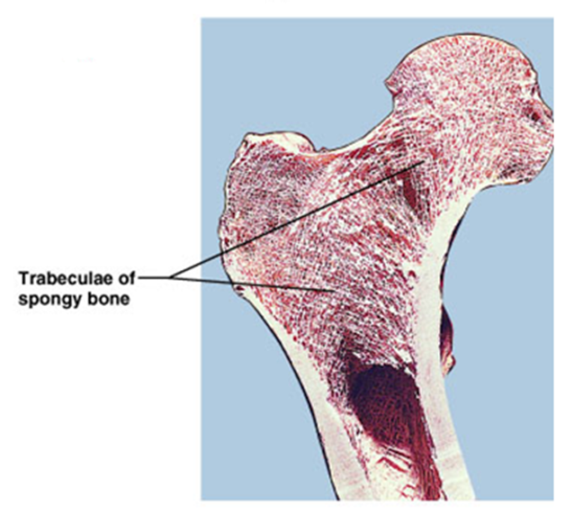
Bone Classification - According to Structure
Compact Bone
dense areas without cavities
sponge bone
Macroscopic or gross observation
Cancellous/Sponge Bone
areas with numerous interconnecting cavities
compact bone

Slide 18
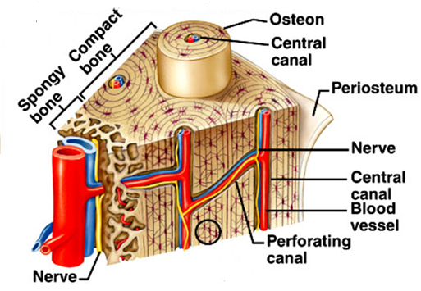
Bone Classification - According to Structure
Microscopic examination
Primary/ immature or Woven bone
1st tissue to appear in embryonic development & fracture repair
random disposition of fine collagen fibers
Secondary / mature Bone / lamellar bone
organizd lamellar disposition of collagen

Slide 19
Bone Classification
According to region
According to structure
According to shape
According to ossification



Slide 20
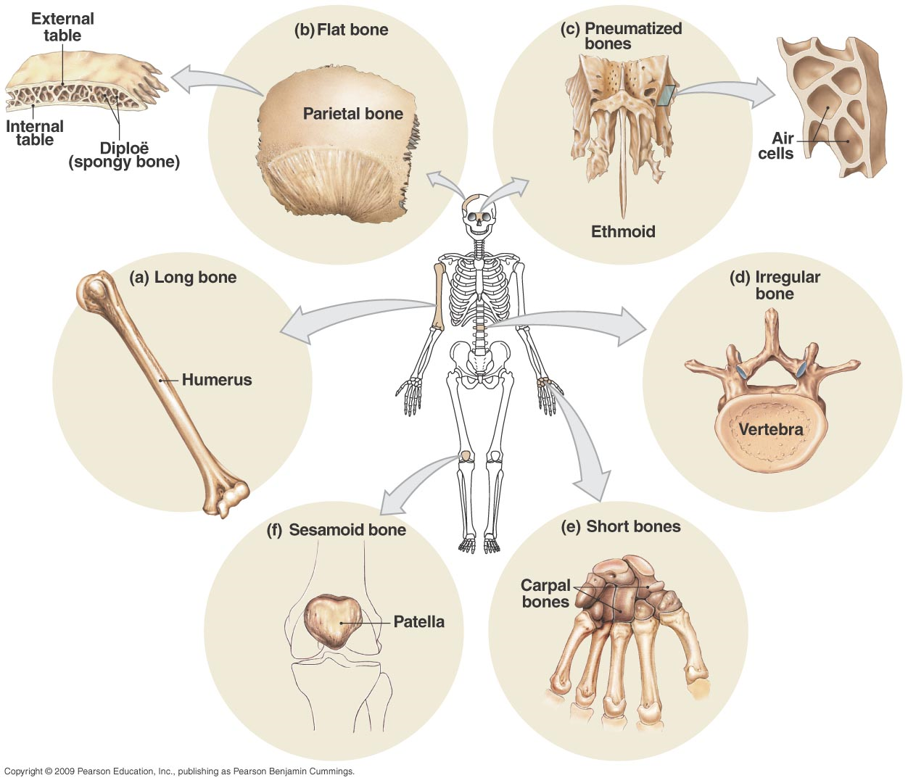
Bone classification - according to shape

Slide 21
Long Bones

Slide 22
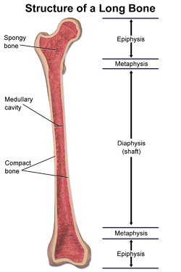
Structure of Long Bones

Slide 23
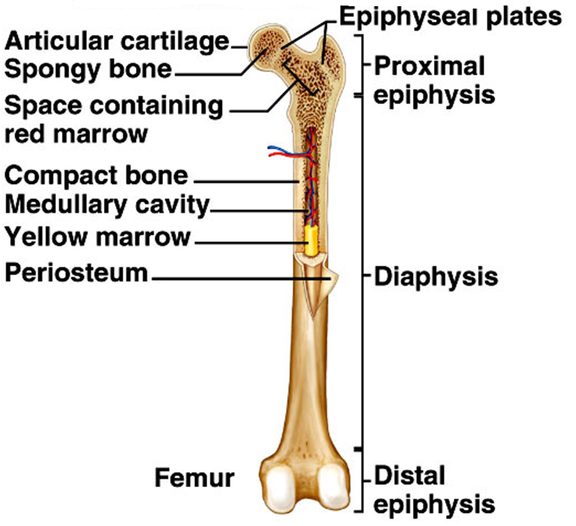
Structure of Long Bones

Slide 24
Structure of Long Bones
Long shaft – diaphysis, totally composed of compact bone the small component of spongy bone on its inner surface
Two ends – epiphysis
composed of spongy bone covered by a thing layer of compact bone
Central medullary cavity except clavicle
Ossification cartilagenous except clavicle*
Position of nutrient foramen away from the growing end
E.g. :
Humerus, Tibia, Femur, Ulna
Metatarsal, metacarpals, phalanges (one epiphysis)

Slide 25
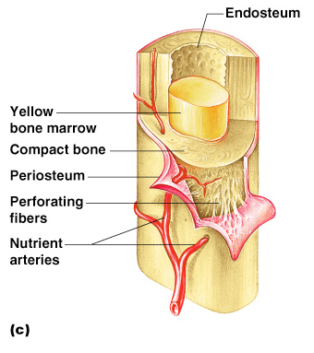
Structure of Long Bones
Periosteum
Outside covering of the diaphysis
Fibrous connective tissue membrane
Two sublayers
Outer fibrous layer of dense irregular connective tissue
Inner cellular osteogenic layer
Endosteum
Covers the internal bone surfaces
Osteogenic layer
Vascular membrane lining the marrow cavity
Sharpey’s fibers
Secure periosteum to underlying bone
Arteries
Supply bone cells with nutrients
Nutrient artery
periosteal arteries
epiphyseal arteries
metaphyseal arteries


Slide 26
Types of Long Bones
Typical – bones of the limbs
Miniature - short long bones having one epiphysis metacarpals
metatarsals
phalanges
Modified – no medullary cavity

Slide 27
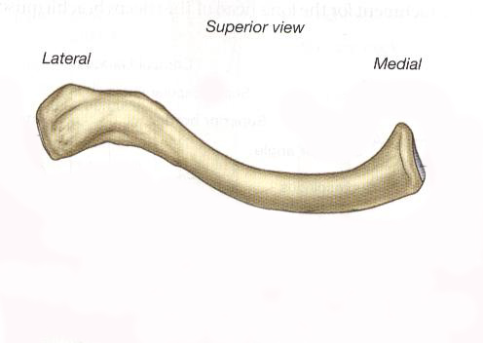
Long Bone – Clavicle
Pay special attention to clavicle ……???

Slide 28
Short Bones

Slide 29
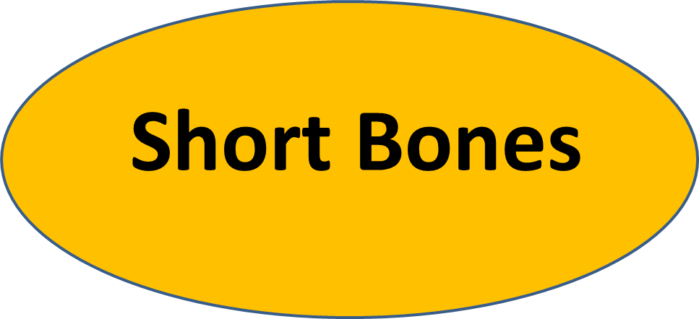
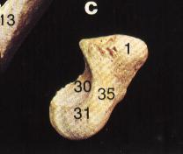
Cubical – Carpals/ Tarsals
Have six surfaces
Usually core of spongy bone completely surrounded by compact bone
Ossification – cartilagenous modle
Arterial supply - periosteal vessels

Slide 30
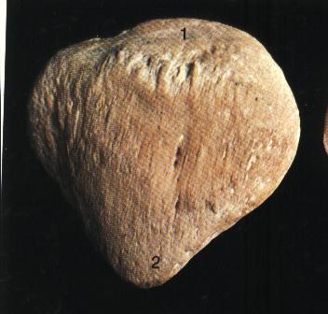
Sesamoid bones
seed like short bones found inside the tendon
E.g. Patella,
Pisiform

Slide 31
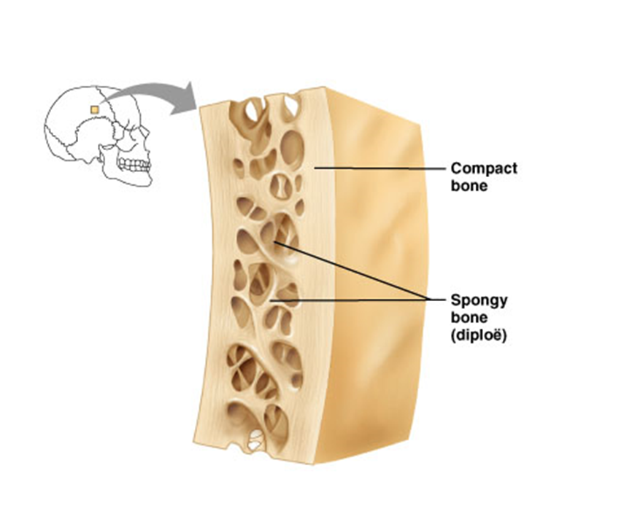
Flat bones
Resembles plate
Two outer plates of compact bone
Inner spongy bone: diploe
Periosteal vessels
Have bone marrow but no marrow cavity
e.g. skull bones
scapula
ribs & sternum

Slide 32
Irregular Bones

Slide 33
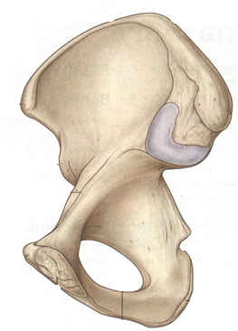
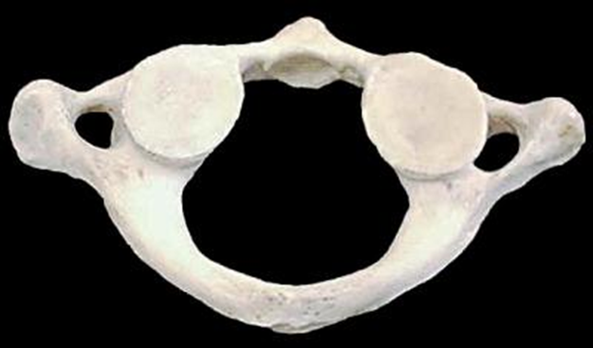
Irregular Bones
Irregular shape
Structurally spongy with covering of compact bone
E.g. Bones of base of the skull hip bone & vertebrae
Arterial supply-
large nutrient artery
periosteal vessels

Slide 34
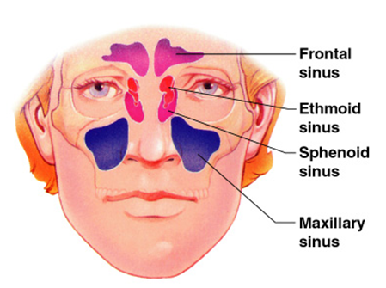
Pneumatic bones
Irregular bones containing air sinuses
Surrounds the nasal cavity
Make the skull lighter
Help in resonance
Act as air conditioning chambers
Humidify and warm up inspired air
Maxilla, frontal, sphenoid, ethmoid bones

Slide 35
Bone Classification
According to region
According to structure
According to shape
According to ossification




Slide 36
Bone Classification - According to ossification
Membranous bone
formed directly from mesenchyme/ ossify in membrane vault of the skull
bones of the face
clavicle
Cartilage bone
develop initially from hyaline cartilage
vertebral column
thoracic cage
bones of the limbs

Slide 37
Bone Surface Markings
Bones are shaped by the tissues that act upon and around them
Bones display bulges, depressions and holes which serve as sites of muscle, ligament and tendon attachment, points of articulation, or as conduits for blood vessels and nerves
Projections from the bone surface include heads, trochanters, spines, and others
Depressions include fossae and grooves

Slide 38
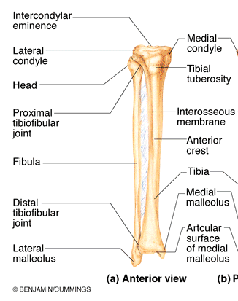
Tuberosity
a large rounded projection which may be roughened
tibial tuberosity

Slide 39
Crest –
A narrow ridge of bone; usually prominent
Crest of the ilium

Slide 40
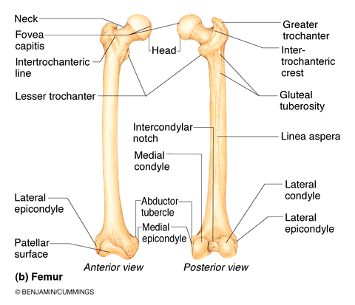
Trochanter
A very large, blunt, irregularly shaped process
Greater trochanter of femur

Slide 41
Line
- Narrow ridge of bone; less prominent than a crest
Intertrochanteric line

Slide 42
Bone Markings
Tubercle - Small rounded projection or process
adductor tubercle

Slide 43
Bone Markings
Condyle - Rounded articular projection
lateral condyle of femur

Slide 44
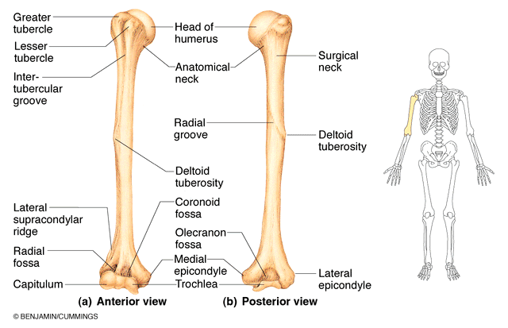
Bone Markings
Epicondyle - raised area on or above a condyle
medial epicondyle of the humerous

Slide 45
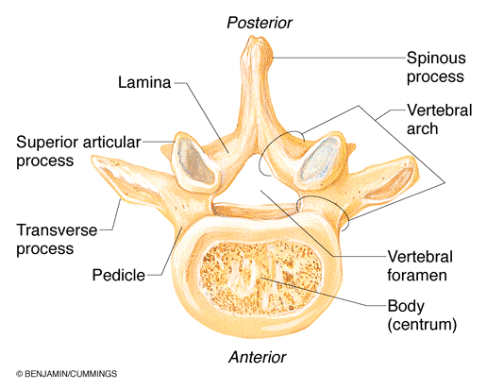
Bone Markings
Spine - A sharp, slender, often pointed projection
Spinous process of vertebrae

Slide 46
Bone Markings
Head - Bony expansion carried on a narrow neck
head of the humerus

Slide 47
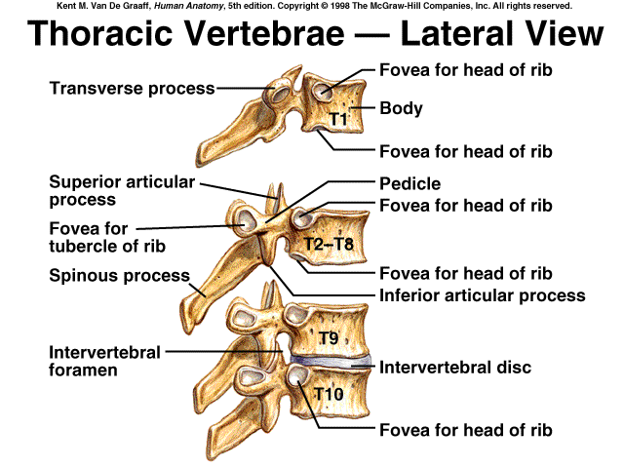
Bone Markings
Facet - Smooth, nearly flat articular surface
facet on transverse process of thoracic vertebrae
Facet

Slide 48
Bone Markings
Ramus - Armlike bar of bone
ramus of the pubis

Slide 49
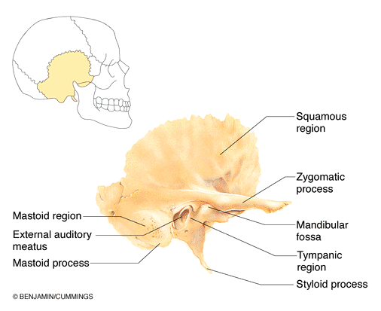
Bone Markings
Meatus - canal-like passageway
External auditory meatus

Slide 50
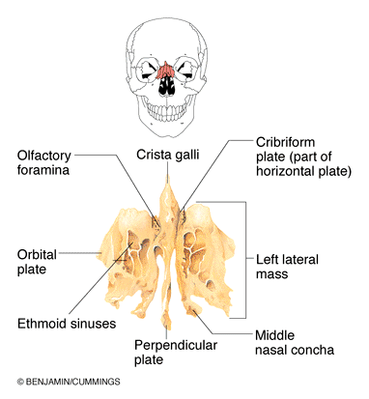
Bone Markings
Sinus - Cavity within a bone, filled with air and lined with mucous membrane
nasal sinus

Slide 51
Bone Markings
Fossa - Shallow, basinlike depression in a bone often serving as an articular surface
Olecranon fossa

Slide 52
Bone Markings
Groove - a narrow furrow in the surface of the bone
radial groove

Slide 53
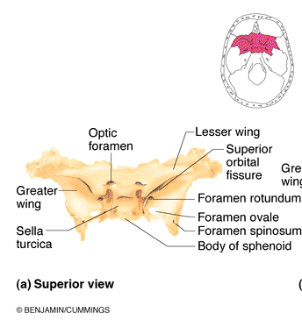
Bone Markings
Fissure - Narrow, slitlike opening

Slide 54
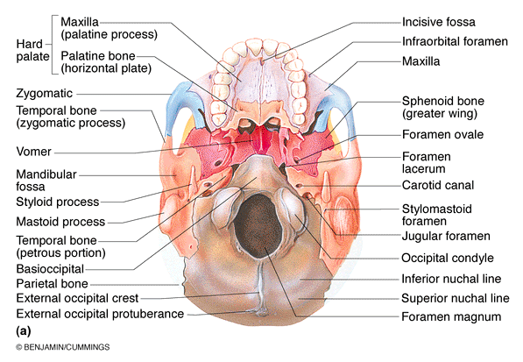
Bone Markings
Foramen - Round or oval opeing through a bone
Foramen magnum

Slide 55
The Skeleton Throughout Life
Bones are a timetable
Mesoderm – gives rise to embryonic mesenchyme cells
Mesenchyme – produces membranes and cartilage
Membranes and cartilage ossify

Slide 56
The Skeleton Throughout Life
Skeleton grows until the age of 18–21 years
In children and adolescents
Bone formation exceeds rate of bone reabsorption
In young adults
Bone formation and bone reabsorption are in balance
In old age reabsorption predominates
Bone mass declines with age

Slide 57
The Skeleton Throughout Life
To have strong bones when you are young, and to prevent bone loss when you are older, you need to get enough
Calcium
Vitamin D
Exercise
There are many kinds of bone problems
Fractures are the commonest problem

Slide 58
Clinical aspects of Bones

Slide 59
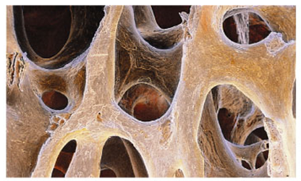
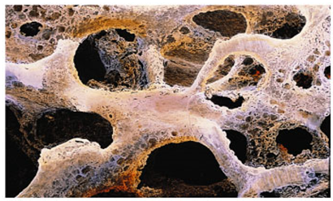
Osteoporosis
Decrease in organic & inorganic components of bone
Characterized by low bone mass – weak bones
Bone reabsorption outpaces bone deposition
Occurs most of in women after menopause
Normal bone
Osteoporotic bone

Slide 60
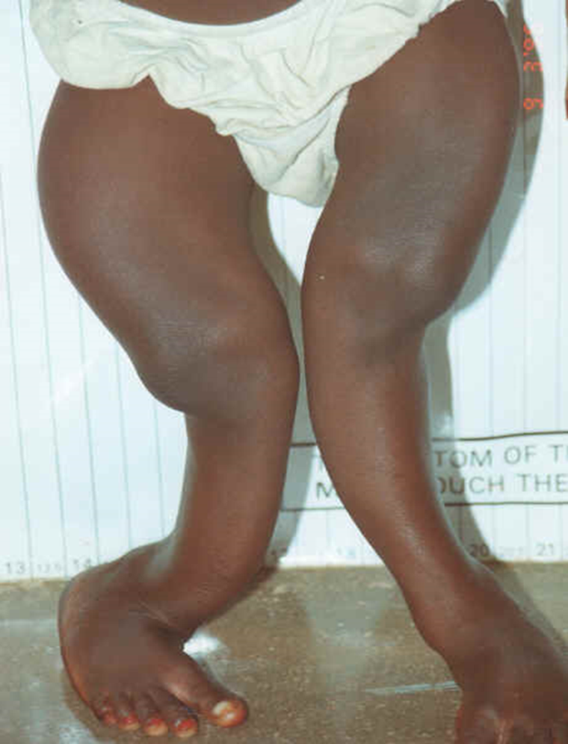
Rickets
Prolonged Vitamin D deficiency in growing children
Unable to absorb calcium and phosphate from gut
Inorganic bone matrix (mineral salts) lacks calcium-
Bones deform

Slide 61
Disorders of Bones
Osteomalacia – occurs in adults – bones are inadequately mineralized & analogous to rickets in children
Paget's disease – characterized by excessive rate of bone deposition
Osteosarcoma – a form of bone cancer

Slide 62
Bone Diagnosis
Bone X-Ray (Radiography)
ALP (Alkaline Phosphatase)
Bone Density Scan
Bone Markers
Bone Scan

Slide 63
REFFERENCES
Snell, R.S., (1992). Clinical anatomy for medical students. 4th ed., Boston: Little , brown & compay .
Drake et al., (2005). Gray’s anatomy for students. Philadelphia: Elsevier Inc.
Romanes, G.J., (1996). Cunninghams manual of practical anatomy. 15th ed., Oxford: Oxford university press

